Slide 1
Slide library
Instructions for all Kuehne+Nagel presentations.
For latest updates and more information, check our branding platform Frontify.
November 2020

Slide 2
KNITS
Kuehne Nagel Information Technology School
Portfolio Program

Slide 3


Portfolio Project
From idea to release
02 Plan
01 Idea
01
02
Analyze and define requirements and tasks
Bring your own idea or choose one from our pool.
04 Success
03 Action
04
03
Show your product and your code to your next job interview
Develop your product with modern frameworks. Deploy your solution on the cloud.
Notes:
© Copyright PresentationGO.com – The free PowerPoint and Google Slides template library

Slide 4


Product Owner
Software Analyst
Frontend Developer
Portfolio Project
Fulfill your potential by exploring many roles
Learn how to design product features
Learn how to analyze business requirements
Learn how to develop user interfaces with modern frontend frameworks
Backend Developer
QA engineer
DevOps
Learn how to implement a backend system accessing database and exposing rest api
Learn how to master best tools and methodologies to achieve and control software quality
Learn how to build and deploy your product on the cloud

Slide 5



Portfolio Project
Full ownership of your product
DATA
CODE
PRODUCT
You will be the owner of product’s data
You will be the owner of product’s code repository
You will be the administrator of product in the cloud services

Slide 6

Portfolio Project
Our dedicated mentorship
Project Evaluation
Assessment of your skill matrix and definition of technology stack
Road Map
Definition of a road map and a curriculum of learning resources for your project
Check Points
Regular sessions with reviews and feedback for your accomplishments
Project Finalization
Your work will be introduced to our teams
Notes:
© Copyright PresentationGO.com – The free PowerPoint and Google Slides template library

Slide 7


Portfolio Project
Join our interns community
Some key benefits for you
Your work will be reviewed by a dedicated mentor
Company learning events
Leisure and sport activities
Privileged access to our internship programs
Possibility for best candidates to join our teams
Please note that this internship program is not compensated

Slide 8

Portfolio Project
This will be our first step together..
..and we believe it will be the beginning of a very beautiful journey

Slide 9
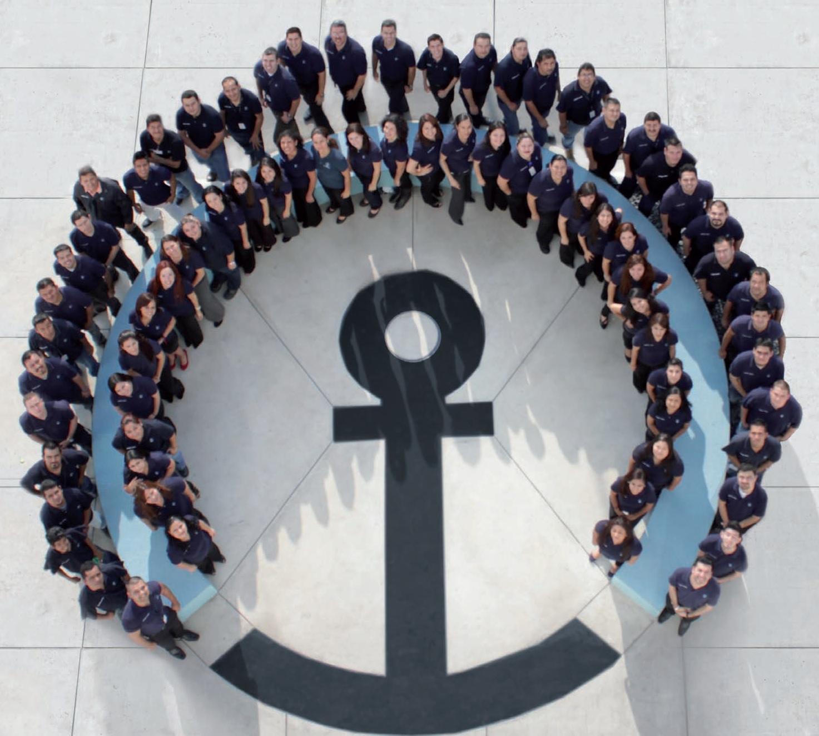
Portfolio Project
Would you like to know more___ ?
Please send an email to knits@kuehne-nagel.com
If you would like to apply please include your:
motivation letter
updated cv
linkedin profile url

Slide 10
New Branding 2020
The slides in this library have been designed to match our new branding principles. We focus on what matters and create compelling stories – in imagery and words. The goal is to give audiences useful information in a way that is human, engaging, and easy to understand.
As a transition from old to new, we have created this initial set of layouts. The library will expand in the coming months. Here are a few things to remember:
Our re-designed logo is set in either dark blue and white. No other colours should be applied to the logo in your presentations.
The new tagline “Inspire. Empower. Deliver.” is used only on the final slide. Please do not include elsewhere in the presentation.
The distinctive colour palette reflects our brand personality and provides visual versatility. Colours from older presentation templates no longer apply.

Slide 11
White
space
Logo
Logo and slide titles
Ideal title space is single line
Additional title space – use only if necessary
The logo placement and slide titles are designed for maximum visibility. They are not to be adjusted, removed or hidden.
Keep titles short and relevant to your audience. Ideal length is one line only.
Stay within the space provided. Do not stretch or move the title box.
The logo must remain visible. Do not remove the logo or cover it with other text, images or white boxes.

Slide 12
Grid Design
Maximum slide work area
Maximum width for text boxes
Maintaining a clean slide design is easiest when objects are aligned on a grid system. The dashed lines you see on this slide divide it into sections that work well on the 16:9 widescreen format.
By placing objects within these areas, you maintain a design that is not only consistent, but also engages the audience.

Slide 13
Text font
The standard font for all text in presentations is: Arial.
It has been chosen because it is available in all Microsoft applications and is closest in style to our corporate font Suisse Intl.
New: Text on the slides is now in Black. Only the header title has KN Dark Blue applied.
Bullet points used throughout the layouts have 3 levels: 1st level is the small filled square, 2nd level is the small filled circle and the 3rd is the short hyphen.
Font sizes and colours are noted in the comments section of each slide (Remember to delete the instructional notes from all slides when using in your own presentation.)

Slide 14
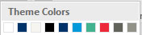
Colour Palette Overview
The distinctive colour palette reflects our brand personality and provides visual versatility in a wide range of design applications. Our new dark blue is brighter and complemented by the light blue and green tones. The coral red should be used sparingly to draw attention to a particular object.
The presentation defaults to a custom colour theme called “KN 2020 Branding”. It appears along the top of all colour drop-down panels.
For instructions on how to change your overall PowerPoint default colour theme to our new palette, click here for a step-by-step guide.
Run the Slide Show to activate links

Slide 15
Colour Palette Details
NOTE: Copying slides between presentation files that do not have this Colour Theme may cause text and object colours to change.
Brand colour
For titles only
Functional colours
Use these colours for charts and graphs / for shapes
KN Dark blue
Standard text
RGB 0-51-105
Hex #003369
KN Dark blue
Standard text
RGB 0 -51-105
Hex #003369
Light blue
Turquoise accent 1
RGB 0-153-218
Hex #0099DA
Light Green
Green accent 2
RGB 8-199-146
Hex #08C792
Coral Red
Red accent 3
RGB 237-41-57
Hex #ED2939
Neutral 4
RGB 98-99-91
Hex # 62635B
Neutral 3
RGB 146-146-136
Hex # 929288
Chart colour sequence:
→
→
→
→
→
Text colour
For text boxes
Neutrals
Black
Standard text
RGB 0-0-0
Hex #000000
Neutral 1
RGB 246-245-240
Hex # F6F5F0
Neutral 2
RGB 197-198-191
Hex # C5C6BF
Neutral 3
RGB 146-146-136
Hex # 929288
Neutral 4
RGB 98-99-91
Hex # 62635B
Neutral 5
RGB 55-56-50
Hex # 373832

Slide 16
Everything else you need to know
Slide Transitions: All slides transition with the subtle Fade option.
Header: The Kuehne+Nagel logo is found in the top right corner of all slides. This should not be covered up or removed.
Footer / Slide Number: As with the previous template, we no longer have default footers at the bottom of the slides. If you wish to insert slide numbers, please do so manually through Insert > Header & Footer and check the Slide Number box. Check the Apply box to add to a single slide or Apply All if you want the number to appear on all slides.
Copyright: The end slide contains copyright information in the bottom left corner. (© 2020 Kuehne + Nagel All rights reserved) Please keep this information intact.

Slide 17
Frontify: Images, icons, logos, and graphics
Our new branding has a graphic quality through the use of straight-on perspective, ample amounts of negative space and a simple organization of subjects and elements. People and image styles are self-confident, active and fresh, and they create a sense of openness to ideas. Content should always be made relevant to the target audience.
All photos, icons, logos, and other graphic elements can be downloaded from our brand management platform Frontify.
Do not use images or graphics from random internet searches that may infringe on copyright.
Important: Pictures on these slides have been resized specifically for PowerPoint. If you replace them with a larger file, use the Picture Tools > Compress Picture option and reduce the size to 150dpi.
Run the Slide Show to activate links

Slide 18
Graphics not displaying properly on your slide
Some users may experience issues with viewing certain images due to an inconsistency between PowerPoint and your computer’s graphics driver. If this happens, please do the following:
Click on the File tab
Select Options
In the options window, click on Advanced
Scroll down to the section: Display
Check ✓ these 2 boxes:
Disable hardware graphics acceleration
Disable Slide Show hardware graphics acceleration

Slide 19
Content Placeholders
Image placeholders: To change images, simply click the existing picture and delete it. Then click on the icon and select a new picture to insert. Using the Picture Change option is not recommended as it does not crop images to fit the space properly.
To learn more about how to work with pictures and their placeholders. Review our video tutorial “Picture Perfect” on Learning@KN PowerPoint Presentation Skills Learning Centre.
Important: Swapping images often brings them to the front of all elements on the slide. If your new picture is covering up other objects on the page, right click on the image and choose Send to Back. These instructions are found in the notes section of each slide. Delete those notes after copying slides to your own presentation.
Text placeholders: Titles and text box placeholders allow for direct entry within the space provided. If fields are left blank, they will not appear in the Slideshow.
Run the Slide Show to activate links

Slide 20
Learn more about creating Presentations
It is anticipated that anyone using this template has a general knowledge of PowerPoint. When you need more information, we have tools to help you learn new techniques.
If you’re looking to gain more expertise, visit our Learning@KN PowerPoint Presentations Skills Learning Centre and watch the tutorials. There are both short and long-form videos available, including How to Use the KN Slide Library.
The community also contains the Great Big Step-by-Step Guide that covers all basic functions of PowerPoint MS Office 2016 (download in PDF format).
Run the Slide Show to activate links

Slide 21
PORTFOLIO
Internship Program

Slide 22

Portfolio Program
From idea to release
02 Plan
01 Idea
01
02
Analyze and define requirements and tasks
Bring your own idea or choose one from our pool.
04 Success
03 Action
04
03
Show your product and your code to your next job interview
Develop your product with modern frameworks. Deploy your solution on the cloud.
Notes:
Key Message Font: Arial bold 36pt black Body Text Font: Arial 24pt black

Slide 23
Portfolio Program
Full ownership of your product
DATA
CODE
PRODUCT
You will be the owner of product’s data
You will be the owner of product’s code repository
You will be the administrator of product in the cloud services
Notes:
Key Message Font: Arial bold 36pt white Body Text Font: Arial 24pt white

Slide 24
Product Owner
Portfolio Program
Full ownership of your product
Notes:
Key Message Font: Arial bold 36pt white Body Text Font: Arial 24pt white

Slide 25
Notes:
This is the standard title slide. It’s used as the very first slide of a Kuehne+Nagel presentation.
See next slide for alternative version with space for customer logos when needed.
Date Font: Arial bold 18pt white Main Title Font: Arial bold 36pt white Presentation Details Font: Arial 24pt white

Slide 26
Notes:
This is the standard title slide with space for customer logos. It’s used as the very first slide of a Kuehne+Nagel presentation.
Date Font: Arial bold 18pt white Main Title Font: Arial bold 36pt white Presentation Details Font: Arial 24pt white
To add a cobranding logo, simply click on the image icon in the box and choose the logo you want
to include into one of these fields (starting on the left) A logo or trademark is any photograph, word, or symbol used to identify a brand, service, or product.
You need permission from its owner to use a logo. You can contact your local legal department if you need help to request and obtain the agreement.

Slide 27
DATA
CODE
PRODUCT
You will be the owner of product’s data
You will be the owner of product’s code repository
You will be the administrator of product in the cloud services
Notes:
This is an alternate title slide. It’s used as the very first slide of a Kuehne+Nagel presentation.
Date Font: Arial bold 18pt white Main Title Font: Arial bold 36pt white
Presentation Details Font: Arial 24pt white

Slide 28
Notes:
This is an alternate title slide. It’s used as the very first slide of a Kuehne+Nagel presentation.
Date Font: Arial bold 18pt white Main Title Font: Arial bold 36pt white
Presentation Details Font: Arial 24pt white

Slide 29
Notes:
This is an alternate title slide. It’s used as the very first slide of a Kuehne+Nagel presentation.
Date Font: Arial bold 18pt white Main Title Font: Arial bold 36pt white
Presentation Details Font: Arial 24pt white

Slide 30
Notes:
This is an alternate title slide. It’s used as the very first slide of a Kuehne+Nagel presentation.
Date Font: Arial bold 18pt white Main Title Font: Arial bold 36pt white
Presentation Details Font: Arial 24pt white

Slide 31

Notes:
This title slide layout is designed with text for images with light colour tones.
Images must be chosen to fit with the layout and allow text to be seen.
You may need to make shorter sentences to fit the space around your chosen image.
Main Title Font: Arial bold 36pt black
Presentation Details Font: Arial 24pt black
Replace the picture: Click the existing picture and delete it. Then click on the icon and select a
new picture to insert. Using the Picture Change option is not recommended as it doesn’t crop images to
fit the space properly. Important: Swapping images automatically brings them to the front of all
elements on the slide. If your new picture is covering up other objects on the page, right click on the
image and choose Send to Back.

Slide 32

Notes:
This title slide layout is designed with text for images with medium to dark colour tones.
Images must be chosen to fit with the layout and allow text to be seen.
You may need to make shorter sentences to fit the space around your chosen image.
Main Title Font: Arial bold 36pt white Presentation Details Font: Arial 24pt white
Overlay: There is a subtle overlay of black gradient underneath the text. This ensures that the text will stand out if the background of the image is in a middle colour range.
Replace the picture: Click the existing picture and delete it. Then click on the icon and select a
new picture to insert. Using the Picture Change option is not recommended as it doesn’t crop images to
fit the space properly. Important: Swapping images automatically brings them to the front of all
elements on the slide. If your new picture is covering up other objects on the page, right click on the
image and choose Send to Back.

Slide 33
Enter Section #
Enter section title 60pt
Notes:
This slide is available to separate presentations into sections
Section Title Font: Arial bold 60pt white

Slide 34
Notes:
This end slide is to be used in all presentations
Do not add other elements to the slide.

Slide 35
Section 2
Agenda

Slide 36
Agenda
Item 1 18pt
Item 2
Item 3
Item 4
Item 5
Item 6
Item 7
Item 8
Item 9
Item 10
Item 11
Item 12
Item 13
Item 14
Item 15
Item 16
Notes:
Agenda Title Font: Arial bold 36pt white Agenda Item Font: Arial bold 18pt white

Slide 37
Agenda
Item 1 18pt
Item 2
Item 3
Item 4
Item 5
Item 6
Item 7
Item 8
Item 9
Item 10
Item 11
Item 12
Item 13
Item 14
Item 16
Item 16
Notes:
Agenda Title Font: Arial bold 36pt black Agenda Item Font: Arial bold 18pt black

Slide 38

Item 1 18pt
Item 2
Item 3
Item 4
Item 5
Item 6
Item 7
Item 8
Item 9
Notes:
This layout is designed with a standard logo for images with light colour tones
Agenda Title Font: Arial bold 24pt bold white Agenda Item Font: Arial bold 18pt white
Replace the picture: Click the existing picture and delete it. Then click on the icon and select a
new picture to insert. Using the Picture Change option is not recommended as it doesn’t crop images to
fit the space properly. Important: Swapping images automatically brings them to the front of all
elements on the slide. If your new picture is covering up other objects on the page, right click on
the image and choose Send to Back.

Slide 39

Item 1 18pt
Item 2
Item 3
Item 4
Item 5
Item 6
Item 7
Item 8
Item 9
Notes:
This layout is designed with a white logo for images with dark colour tones
Agenda Title Font: Arial bold 24pt bold white Agenda Item Font: Arial bold 18pt white
Replace the picture: Click the existing picture and delete it. Then click on the icon and select a
new picture to insert. Using the Picture Change option is not recommended as it doesn’t crop images to
fit the space properly. Important: Swapping images automatically brings them to the front of all
elements on the slide. If your new picture is covering up other objects on the page, right click on
the image and choose Send to Back.

Slide 40

Item 1 18pt
Item 2
Item 3
Item 4
Item 5
Item 6
Item 7
Item 8
Item 9
Notes:
This layout is designed with a standard logo for images with light colour tones
Agenda Title Font: Arial bold 24pt bold KN dark blue Agenda Item Font: Arial bold 18pt black
Replace the picture: Click the existing picture and delete it. Then click on the icon and select a
new picture to insert. Using the Picture Change option is not recommended as it doesn’t crop images to
fit the space properly. Important: Swapping images automatically brings them to the front of all
elements on the slide. If your new picture is covering up other objects on the page, right click on
the image and choose Send to Back.

Slide 41

Item 1 18pt
Item 2
Item 3
Item 4
Item 5
Item 6
Item 7
Item 8
Item 9
Notes:
This layout is designed with a white logo for images with dark colour tones
Agenda Title Font: Arial bold 24pt bold KN dark blue Agenda Item Font: Arial bold 18pt black
Replace the picture: Click the existing picture and delete it. Then click on the icon and select a
new picture to insert. Using the Picture Change option is not recommended as it doesn’t crop images to
fit the space properly. Important: Swapping images automatically brings them to the front of all
elements on the slide. If your new picture is covering up other objects on the page, right click on
the image and choose Send to Back.

Slide 42
Section 3
Text-based
slides

Slide 43
Enter body text 18pt
Notes:
Title Font: Arial bold 24pt KN Dark blue Body Text Font: Arial 18pt black

Slide 44
Enter subtitle text 18pt
Enter body text 18pt
Notes:
Title Font: Arial bold 24pt KN Dark blue Subtitle Font: Arial bold 18pt black Body Text Font: Arial 18pt black

Slide 45
Enter bullet point level one 18pt
Enter bullet point level two
Enter bullet point level three
Enter bullet point level three
Enter bullet point level one 18pt
Enter bullet point level two
Enter bullet point level three
Enter bullet point level three
Notes:
Title Font: Arial bold 24pt KN Dark blue Bullet Point Level 1 Font: Arial bold 18pt black
Bullet Point Level 2 & 3 Font: Arial 18pt black

Slide 46
Enter key message 36pt
Enter body text 24pt
Notes:
Key Message Font: Arial bold 36pt black Body Text Font: Arial 24pt black

Slide 47
Enter key message 36pt
Enter body text 24pt
Notes:
Key Message Font: Arial bold 36pt white Body Text Font: Arial 24pt white

Slide 48
Enter key message text in this area. You can highlight specific words or phrases to make them stand out by changing the colour to light blue.
Text is 36pt
Notes:
Key Message Font: Arial bold 36pt white

Slide 49
Enter key message 36pt
Enter body text 24pt
Notes:
Key Message Font: Arial bold 36pt black Body Text Font: Arial 24pt black

Slide 50
Enter key message 36pt
Enter body text 24pt
Notes:
Key Message Font: Arial bold 36pt white Body Text Font : Arial 24pt white

Slide 51
02
01
Enter key message on these two lines 36pt
Enter body text 24pt
Main title, Arial bold 36pt
Subtitle, Arial regular 24pt
Notes:
Number Font: Arial bold 180pt white Key Message Font: Arial bold 36pt white Body Text Font: Arial 24pt white

Slide 52
02
02
Enter key message on these two lines 36pt
Enter body text 24pt
Main title, Arial bold 36pt
Subtitle, Arial regular 24pt
Notes:
Number Font: Arial bold 180pt white Key Message Font: Arial bold 36pt white Body Text Font: Arial 24pt white

Slide 53
Section 4
Text with
images

Slide 54

Enter key message text 36pt
Enter body text 24pt
Notes:
Key Message Font: Arial bold 36pt black Body Text Font: Arial 24pt black
Replace the picture: Click the existing picture and delete it. Then click on the icon and select a
new picture to insert. Using the Picture Change option is not recommended as it doesn’t crop images to
fit the space properly. Important: Swapping images automatically brings them to the front of all
elements on the slide. If your new picture is covering up other objects on the page, right click on
the image and choose Send to Back.

Slide 55
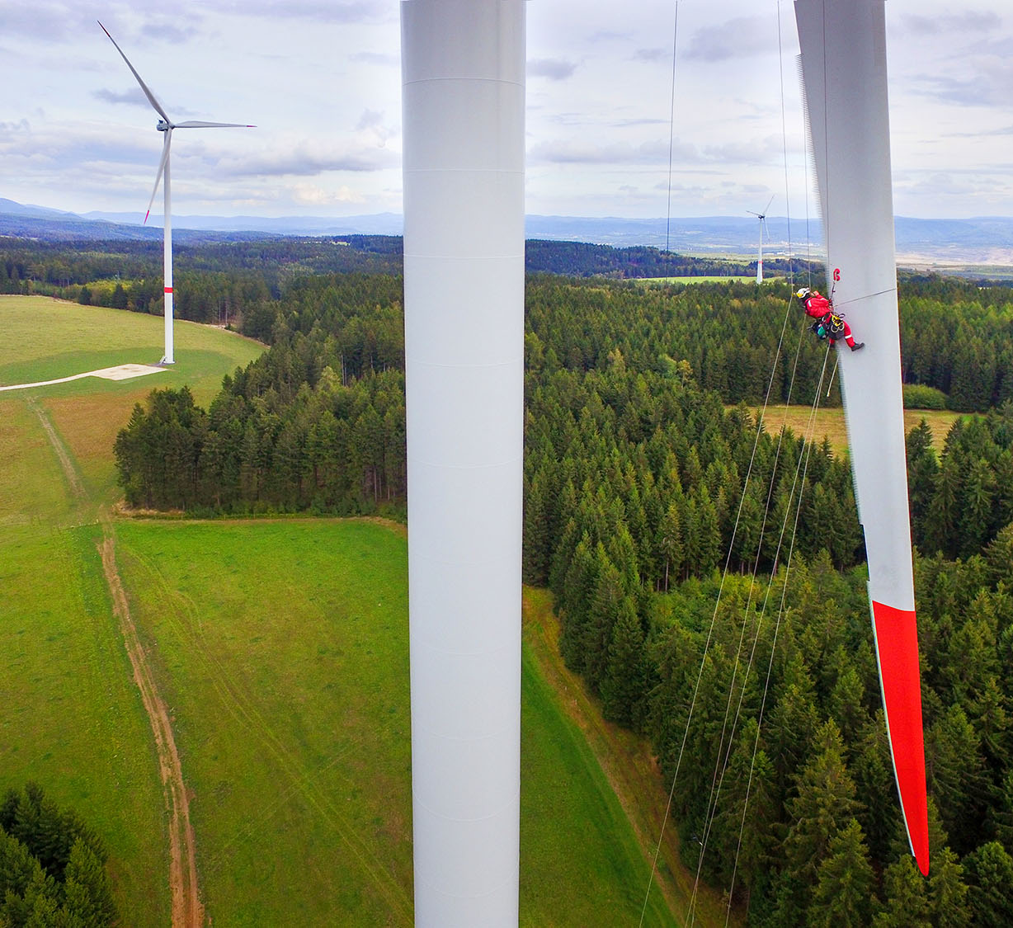
Enter key message 36pt
Enter body text 24pt
Notes:
This layout is designed with a standard logo for images with light colour tones
Key Message Font: Arial bold 36pt white Body Text Font: Arial 24pt white
Replace the picture: Click the existing picture and delete it. Then click on the icon and select a
new picture to insert. Using the Picture Change option is not recommended as it doesn’t crop images to
fit the space properly. Important: Swapping images automatically brings them to the front of all
elements on the slide. If your new picture is covering up other objects on the page, right click on
the image and choose Send to Back.

Slide 56

Enter key message 36pt
Enter body text 24pt
Notes:
This layout is designed with a white logo for images with dark colour tones
Key Message Font: Arial bold 36pt white Body Text Font: Arial 24pt white
Replace the picture: Click the existing picture and delete it. Then click on the icon and select a
new picture to insert. Using the Picture Change option is not recommended as it doesn’t crop images to
fit the space properly. Important: Swapping images automatically brings them to the front of all
elements on the slide. If your new picture is covering up other objects on the page, right click on
the image and choose Send to Back.

Slide 57

Enter a key message with specific words highlighted in light blue.
Text is 36pt
Notes:
This layout is designed with a white logo for images with dark colour tones
Key Message Font: Arial bold 36pt white Body Text Font: Arial 24pt white
Replace the picture: Click the existing picture and delete it. Then click on the icon and select a
new picture to insert. Using the Picture Change option is not recommended as it doesn’t crop images to
fit the space properly. Important: Swapping images automatically brings them to the front of all
elements on the slide. If your new picture is covering up other objects on the page, right click on
the image and choose Send to Back.

Slide 58

Enter a key message with specific words highlighted in light blue.
Text is 36pt
Notes:
This layout is designed with a standard logo for images with light colour tones
Key Message Font: Arial bold 36pt white Body Text Font: Arial 24pt white
Replace the picture: Click the existing picture and delete it. Then click on the icon and select a
new picture to insert. Using the Picture Change option is not recommended as it doesn’t crop images to
fit the space properly. Important: Swapping images automatically brings them to the front of all
elements on the slide. If your new picture is covering up other objects on the page, right click on
the image and choose Send to Back.

Slide 59

Enter key message text 36pt
Enter body text 24pt
Notes:
Key Message Font: Arial bold 36pt white Body Text Font: Arial 24pt white
Replace the picture: Click the existing picture and delete it. Then click on the icon and select a
new picture to insert. Using the Picture Change option is not recommended as it doesn’t crop images to
fit the space properly. Important: Swapping images automatically brings them to the front of all
elements on the slide. If your new picture is covering up other objects on the page, right click on
the image and choose Send to Back.

Slide 60
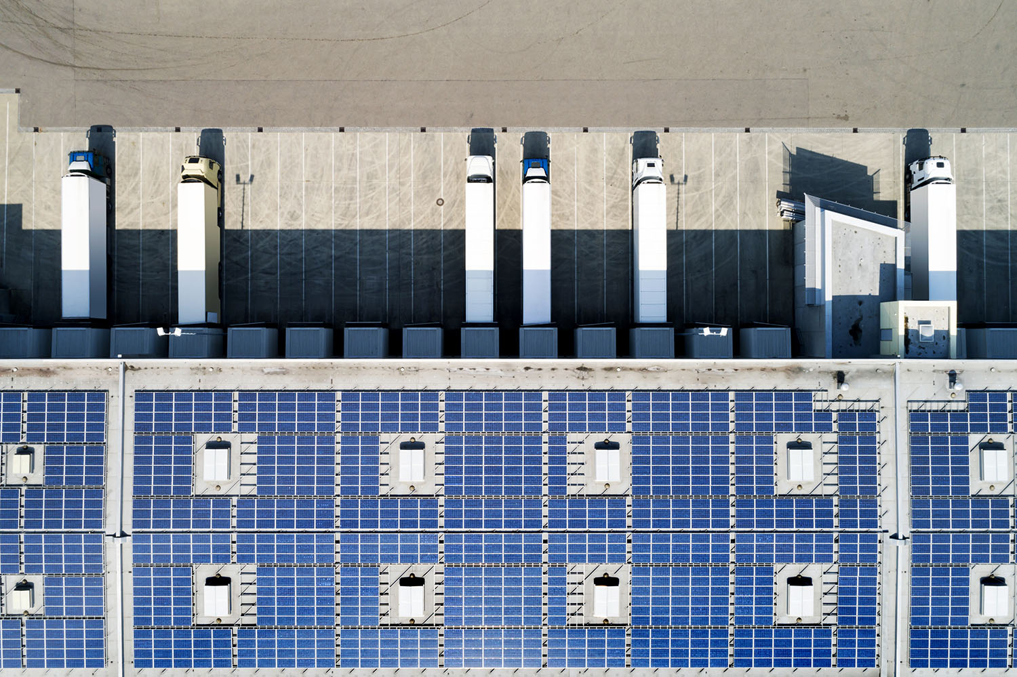
Enter subtitle text 18pt
Enter body text 18pt
Notes:
Title Font: Arial bold 24pt KN Dark blue Subtitle Font: Arial bold 18pt black Text Font: Arial 18pt black
Replace the pictureClick the existing picture and delete it. Then click on the icon and select a
new picture to insert. Using the Picture Change option is not recommended as it doesn’t crop images to
fit the space properly. Important: Swapping images automatically brings them to the front of all
elements on the slide. If your new picture is covering up other objects on the page, right click on
the image and choose Send to Back.

Slide 61

Enter subtitle text 18pt
Enter body text 18pt
Notes:
This layout is designed with a standard logo for images with light colour tones
Title Font: Arial bold 24pt KN Dark blue Subtitle Font: Arial bold 18pt black Text Font: Arial 18pt black
Replace the picture: Click the existing picture and delete it. Then click on the icon and select a
new picture to insert. Using the Picture Change option is not recommended as it doesn’t crop images to
fit the space properly. Important: Swapping images automatically brings them to the front of all
elements on the slide. If your new picture is covering up other objects on the page, right click on
the image and choose Send to Back.

Slide 62

Enter subtitle text 18pt
Enter body text 18pt
Notes:
This layout is designed with a white logo for images with dark colour tones
Title Font: Arial bold 24pt KN Dark blue Subtitle Font: Arial bold 18pt black Text Font: Arial 18pt black
Replace the picture: Click the existing picture and delete it. Then click on the icon and select a
new picture to insert. Using the Picture Change option is not recommended as it doesn’t crop images to
fit the space properly. Important: Swapping images automatically brings them to the front of all
elements on the slide. If your new picture is covering up other objects on the page, right click on
the image and choose Send to Back.

Slide 63



Challenge
Solution
Results
Notes:
This layout is designed with a standard logo for images with light colour tones
Title Font: Arial bold 24pt KN Dark blue Case study section font: Arial bold 18pt black Text Font: Arial 14pt black
Change the icons: You may swap the icons for ones you prefer in Frontify
Replace the picture: Click the existing picture and delete it. Then click on the icon and select a
new picture to insert. Using the Picture Change option is not recommended as it doesn’t crop images to
fit the space properly. Important: Swapping images automatically brings them to the front of all
elements on the slide. If your new picture is covering up other objects on the page, right click on
the image and choose Send to Back.

Slide 64

Challenge
Solution
Results
Notes:
This layout is designed with a white logo for images with dark colour tones
Title Font: Arial bold 24pt KN Dark blue Case study section font: Arial bold 18pt black Text Font: Arial 14pt black
Change the icons: You may swap the icons for ones you prefer in Frontify
Replace the picture: Click the existing picture and delete it. Then click on the icon and select a
new picture to insert. Using the Picture Change option is not recommended as it doesn’t crop images to
fit the space properly. Important: Swapping images automatically brings them to the front of all
elements on the slide. If your new picture is covering up other objects on the page, right click on
the image and choose Send to Back.

Slide 65

Challenge
Solution
Results
Notes:
Title Font: Arial bold 24pt KN Dark blue Case study section font: Arial bold 18pt black Text Font: Arial 14pt black
Replace the picture: Click the existing picture and delete it. Then click on the icon and select a
new picture to insert. Using the Picture Change option is not recommended as it doesn’t crop images to
fit the space properly. Important: Swapping images automatically brings them to the front of all
elements on the slide. If your new picture is covering up other objects on the page, right click on
the image and choose Send to Back.

Slide 66
Challenge
Solution
Results
Notes:
Title Font: Arial bold 24pt KN Dark blue Case study section font: Arial bold 18pt black Text Font: Arial 14pt black
Change the icons: You may swap the icons for ones you prefer in Frontify

Slide 67
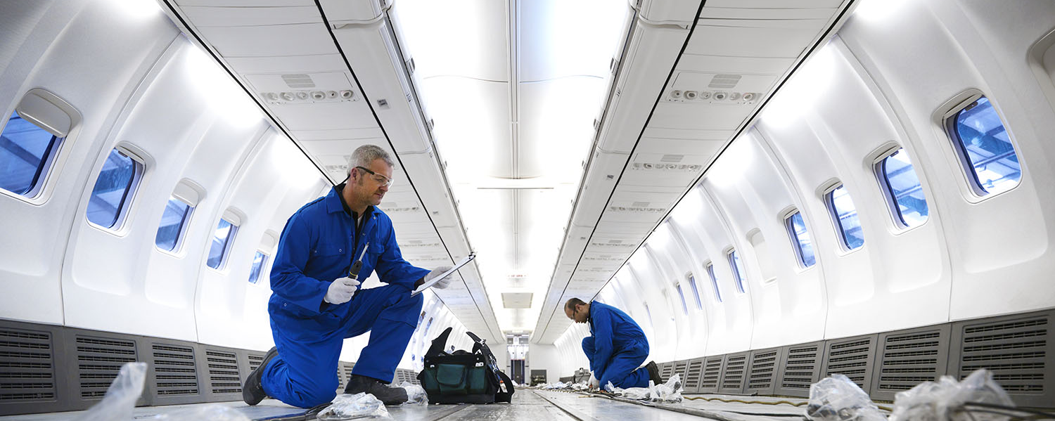
Enter key message 24pt
Notes:
This layout is designed with a standard logo for images with light colour tones
Message Font: Arial bold 24pt white
Replace the picture: Click the existing picture and delete it. Then click on the icon and select a
new picture to insert. Using the Picture Change option is not recommended as it doesn’t crop images to
fit the space properly. Important: Swapping images automatically brings them to the front of all
elements on the slide. If your new picture is covering up other objects on the page, right click on
the image and choose Send to Back.

Slide 68
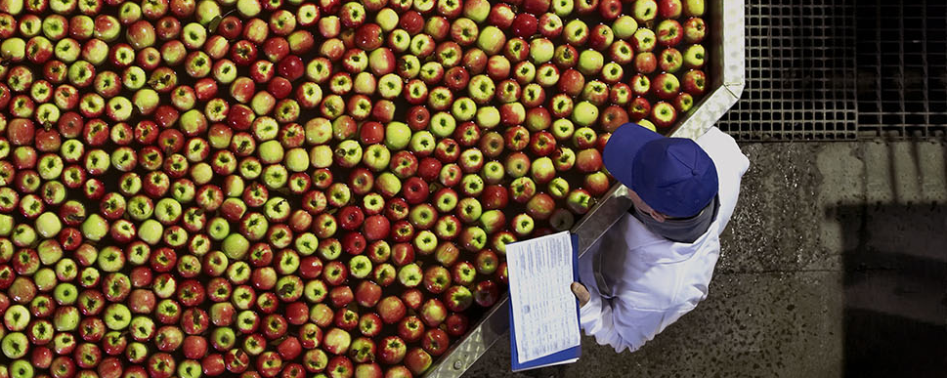
Enter key message 24pt
Notes:
This layout is designed with a standard logo for images with dark colour tones
Message Font: Arial bold 24pt white
Replace the picture: Click the existing picture and delete it. Then click on the icon and select a
new picture to insert. Using the Picture Change option is not recommended as it doesn’t crop images to
fit the space properly. Important: Swapping images automatically brings them to the front of all
elements on the slide. If your new picture is covering up other objects on the page, right click on
the image and choose Send to Back.

Slide 69

Enter body text 18pt
Notes:
Title Font: Arial bold 24pt KN dark blue Body Text Font: Arial 18pt black
Replace the picture: Click the existing picture and delete it. Then click on the icon and select a
new picture to insert. Using the Picture Change option is not recommended as it doesn’t crop images to
fit the space properly. Important: Swapping images automatically brings them to the front of all
elements on the slide. If your new picture is covering up other objects on the page, right click on
the image and choose Send to Back.

Slide 70


Enter body text 18pt
Notes:
Title Font: Arial bold 24pt KN Dark blue Body Text Font: Arial 18pt black
Replace the picture: Click the existing picture and delete it. Then click on the icon and select a
new picture to insert. Using the Picture Change option is not recommended as it doesn’t crop images to
fit the space properly. Important: Swapping images automatically brings them to the front of all
elements on the slide. If your new picture is covering up other objects on the page, right click on
the image and choose Send to Back.

Slide 71

Enter key message or title text 36pt
Enter body text 24pt
Notes:
This layout is designed with a standard logo for images with light colour tones
Message Font: Arial bold 36pt white Body Text Font: Arial 24pt white
Replace the picture: Click the existing picture and delete it. Then click on the icon and select a
new picture to insert. Using the Picture Change option is not recommended as it doesn’t crop images to
fit the space properly. Important: Swapping images automatically brings them to the front of all
elements on the slide. If your new picture is covering up other objects on the page, right click on
the image and choose Send to Back.

Slide 72

Enter key message or title text 36pt
Enter body text 24pt
Notes:
This layout is designed with a standard logo for images with light colour tones
Message Font: Arial bold 36pt white Body Text Font: Arial 24pt white
Replace the picture: Click the existing picture and delete it. Then click on the icon and select a
new picture to insert. Using the Picture Change option is not recommended as it doesn’t crop images to
fit the space properly. Important: Swapping images automatically brings them to the front of all
elements on the slide. If your new picture is covering up other objects on the page, right click on
the image and choose Send to Back.

Slide 73

Enter a key message with specific words highlighted in light blue. Text is 36pt
Notes:
This layout is designed with a standard logo for images with light colour tones
Message Font: Arial bold 36pt white Body Text Font: Arial 24pt white
Replace the picture: Click the existing picture and delete it. Then click on the icon and select a
new picture to insert. Using the Picture Change option is not recommended as it doesn’t crop images to
fit the space properly. Important: Swapping images automatically brings them to the front of all
elements on the slide. If your new picture is covering up other objects on the page, right click on
the image and choose Send to Back.

Slide 74

Enter a key message with specific words highlighted in light blue. Text is 36pt
Notes:
This layout is designed with a standard logo for images with light colour tones
Message Font: Arial bold 36pt white Body Text Font: Arial 24pt white
Replace the picture: Click the existing picture and delete it. Then click on the icon and select a
new picture to insert. Using the Picture Change option is not recommended as it doesn’t crop images to
fit the space properly. Important: Swapping images automatically brings them to the front of all
elements on the slide. If your new picture is covering up other objects on the page, right click on
the image and choose Send to Back.

Slide 75

Title text 36pt
“quote text 24pt – enter up to a maximum of 7 lines”
Notes:
This layout is designed with a standard logo for images with dark colour tones
Message Font: Arial bold 36pt white Quote Text Font: Arial 24pt white
Replace the picture: Click the existing picture and delete it. Then click on the icon and select a
new picture to insert. Using the Picture Change option is not recommended as it doesn’t crop images to
fit the space properly. Important: Swapping images automatically brings them to the front of all
elements on the slide. If your new picture is covering up other objects on the page, right click on
the image and choose Send to Back.

Slide 76

Title text 36pt
“quote text 24pt – enter up to a maximum of 7 lines”
Notes:
This layout is designed with a white logo for images with dark colour tones
Message Font: Arial bold 36pt white Quote Text Font: Arial 24pt white
Replace the picture: Click the existing picture and delete it. Then click on the icon and select a
new picture to insert. Using the Picture Change option is not recommended as it doesn’t crop images to
fit the space properly. Important: Swapping images automatically brings them to the front of all
elements on the slide. If your new picture is covering up other objects on the page, right click on
the image and choose Send to Back.

Slide 77

Enter key message or title text 36pt
Enter body text 24pt
Notes:
Message Font: Arial bold 36pt white Body Text Font: Arial 24pt white
Replace the picture: Click the existing picture and delete it. Then click on the icon and select a
new picture to insert. Using the Picture Change option is not recommended as it doesn’t crop images to
fit the space properly. Important: Swapping images automatically brings them to the front of all
elements on the slide. If your new picture is covering up other objects on the page, right click on
the image and choose Send to Back.

Slide 78

Enter a key message with specific words highlighted in light blue. Text is 36pt
Notes:
Message Font: Arial bold 36pt white Body Text Font: Arial 24pt white
Replace the picture: Click the existing picture and delete it. Then click on the icon and select a
new picture to insert. Using the Picture Change option is not recommended as it doesn’t crop images to
fit the space properly. Important: Swapping images automatically brings them to the front of all
elements on the slide. If your new picture is covering up other objects on the page, right click on
the image and choose Send to Back.

Slide 79

Enter key message or title text 36pt
Enter body text 24pt
Notes:
This layout is designed with a white logo for images with dark colour tones
Message Font: Arial bold 36pt white Body Text Font: Arial 24pt white
Replace the picture: : Click the existing picture and delete it. Then click on the icon and select a
new picture to insert. Using the Picture Change option is not recommended as it doesn’t crop images to
fit the space properly. Important: Swapping images automatically brings them to the front of all
elements on the slide. If your new picture is covering up other objects on the page, right click on
the image and choose Send to Back.

Slide 80

Enter key message or title text 36pt
Enter body text 24pt
Notes:
This layout is designed with a standard logo for images with light colour tones
Message Font: Arial bold 36pt white Body Text Font: Arial 24pt white
Replace the picture: Click the existing picture and delete it. Then click on the icon and select a
new picture to insert. Using the Picture Change option is not recommended as it doesn’t crop images to
fit the space properly. Important: Swapping images automatically brings them to the front of all
elements on the slide. If your new picture is covering up other objects on the page, right click on
the image and choose Send to Back.

Slide 81

Q&A

Slide 82

Notes:
Main title font: Arial bold 24pt Dark blue Column title font: Arial 18pt bold black
Column body text font: Arial 14pt black
Replace the picture: Click the existing picture and delete it. Then click on the icon and select a
new picture to insert. Using the Picture Change option is not recommended as it doesn’t crop images to
fit the space properly. Important: Swapping images automatically brings them to the front of all
elements on the slide. If your new picture is covering up other objects on the page, right click on
the image and choose Send to Back.

Slide 83



Notes:
Main title font: Arial bold 24pt Dark blue Column title font: Arial 18pt bold black
Column body text font: Arial 14pt black
Replace the picture: Click the existing picture and delete it. Then click on the icon and select a
new picture to insert. Using the Picture Change option is not recommended as it doesn’t crop images to
fit the space properly. Important: Swapping images automatically brings them to the front of all
elements on the slide. If your new picture is covering up other objects on the page, right click on
the image and choose Send to Back.

Slide 84


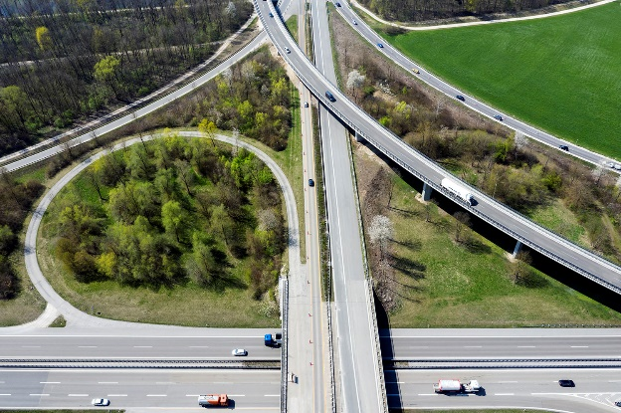

Notes:
Main title font: Arial bold 24pt Dark blue Column title font: Arial 18pt bold black
Column body text font: Arial 14pt black
Replace the picture: Click the existing picture and delete it. Then click on the icon and select a
new picture to insert. Using the Picture Change option is not recommended as it doesn’t crop images to
fit the space properly. Important: Swapping images automatically brings them to the front of all
elements on the slide. If your new picture is covering up other objects on the page, right click on
the image and choose Send to Back.

Slide 85
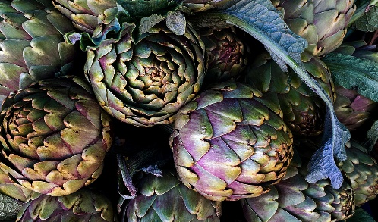

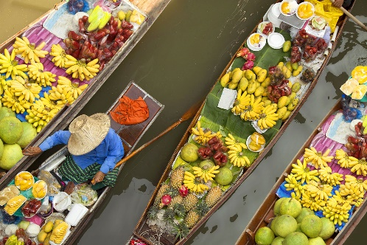

Notes:
Main title font: Arial bold 24pt Dark blue Column title font: Arial 18pt bold black
Column body text font: Arial 14pt black
Replace the picture: Click the existing picture and delete it. Then click on the icon and select a
new picture to insert. Using the Picture Change option is not recommended as it doesn’t crop images to
fit the space properly. Important: Swapping images automatically brings them to the front of all
elements on the slide. If your new picture is covering up other objects on the page, right click on
the image and choose Send to Back.

Slide 86

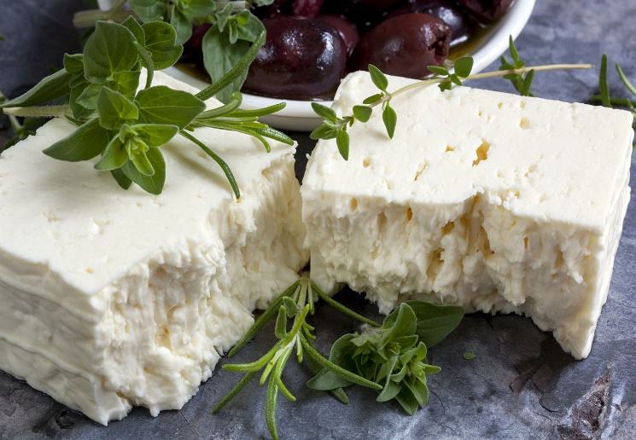

Notes:
Main title font: Arial bold 24pt Dark blue Column title font: Arial 18pt bold black
Column body text font: Arial 14pt black
Replace the picture: Click the existing picture and delete it. Then click on the icon and select a
new picture to insert. Using the Picture Change option is not recommended as it doesn’t crop images to
fit the space properly. Important: Swapping images automatically brings them to the front of all
elements on the slide. If your new picture is covering up other objects on the page, right click on
the image and choose Send to Back.

Slide 87

Notes:
Main title font: Arial bold 24pt Dark blue Message text font: Arial 36pt bold black
Replace the picture: Click the existing picture and delete it. Then click on the icon and select a
new picture to insert. Using the Picture Change option is not recommended as it doesn’t crop images to
fit the space properly. Important: Swapping images automatically brings them to the front of all
elements on the slide. If your new picture is covering up other objects on the page, right click on
the image and choose Send to Back.

Slide 88

Notes:
Main title font: Arial bold 24pt Dark blue Message text font: Arial 36pt bold black
Replace the picture: Click the existing picture and delete it. Then click on the icon and select a
new picture to insert. Using the Picture Change option is not recommended as it doesn’t crop images to
fit the space properly. Important: Swapping images automatically brings them to the front of all
elements on the slide. If your new picture is covering up other objects on the page, right click on
the image and choose Send to Back.

Slide 89



Notes:
Main title font: Arial bold 24pt Dark blue Body Text Font: Arial 14pt black
Replace the pictures: Click the existing picture and delete it. Then click on the icon and select a
new picture to insert. Using the Picture Change option is not recommended as it doesn’t crop images to
fit the space properly. Important: Swapping images automatically brings them to the front of all
elements on the slide. If your new picture is covering up other objects on the page, right click on
the image and choose Send to Back.

Slide 90
Section 5
Tables and
charts

Slide 91
Table title text 18pt
Title, Arial bold 14pt | Title | Title | Title | Title
Category 1, Arial regular 14pt
Category 2
Category 3
Category 4
Total
Title, Arial bold 14pt | Title | Title | Title | Title
Category 1, Arial regular 14pt
Category 2
Category 3
Category 4
Total
Notes:
Title Font: Arial bold 24pt KN Dark blue Table Title Font: Arial bold 18pt black
Table Font: Arial 14pt: Bold white for title, black for data, and Bold black for Total Line

Slide 92
Table title text 18pt
Title, Arial bold 14pt | Title | Title | Title | Title
Category 1, Arial regular 14pt
Category 2
Category 3
Category 4
Total
Notes:
Title Font: Arial bold 24pt KN Dark blue Table Title Font: Arial bold 18pt black
Table Font: Arial 14pt: Bold white for title, black for data, and Bold black for Total Line

Slide 93
Table Title 18pt
Table body text 18pt
Title, Arial bold 14pt | Title | Title
Category 1, Arial regular 14pt
Category 2
Category 3
Category 4
Total
Notes:
Title Font: Arial bold 24pt KN Dark blue Table Body Text: Arial 18pt black
Table Title Font: Arial bold 18pt black
Table Font: Arial 14pt: Bold white for title, black for data, and Bold black for Total Line

Slide 94
Table body text 18pt
Title, Arial bold 14pt | Title | Title
Category 1, Arial regular 14pt
Category 2
Category 3
Category 4
Total
Notes:
Title Font: Arial bold 24pt KN Dark blue Table Body Text: Arial 18pt black
Table Font: Arial 14pt: Bold white for title, black for data, and Bold black for Total Line

Slide 95
Table title text 18pt
Body text 18pt
Notes:
Title Font: Arial bold 24pt KN Dark blue Chart Title Text: Arial Bold 18pt black
Chart Body Text: Arial 18pt black Chart Legend Font: Arial 14pt (chart colours default)

Slide 96
Graphic body text 18pt
Notes:
Title Font: Arial bold 24pt KN Dark blue Chart Body Text: Arial 18pt black
Chart Legend Font: Arial 14pt (chart colour defaults)

Slide 97
Notes:
Title Font: Arial bold 24pt KN Dark blue Chart Title Text: Arial Bold 18pt black
Chart Body Text: Arial 18pt black Chart Legend Font: Arial 14pt (chart colours default)

Slide 98
60%
76%
35%
10%
Chart title text 18pt
Body text 14pt
Notes:
Title Font: Arial bold 24pt KN Dark blue Chart Title Text: Arial bold 18pt black
Chart Body Text Font: Arial 14pt white Chart Text Lines: Arial Bold 14pt (chart colour defaults)

Slide 99
60%
76%
35%
10%
Notes:
Main title font: Arial bold 24pt KN dark blue
Chart colours: Light gray with 1. dark blue 2. light blue 3. light green 4. gray accent 6
Bar chart number font: Arial bold 18pt black Chart text font: Arial 16pt black
Changing the bar chart: Click on the outermost bounding box. Right click on the edge
and select Edit Data. Enter the amount you want to show in colour in the first column and the
balance in the second (add up to 100%.) Close the data window. Update the % text directly on
each chart to match your amount shown.

Slide 100
Notes:
Title Font: Arial bold 24pt KN Dark blue Graphic Text: Arial 14pt bold black

Slide 101
Circle text description
Chart body text 18pt
Chart Title
Circle text description
Circle text description
Notes:
Title Font: Arial bold 24pt KN Dark blue Chart Body Text: Arial 18pt black
Chart Ttile Font: Arial Bold 18pt white Chart Text Lines Font: Arial Bold 14pt black

Slide 102
Circle text description
Chart body text 18pt
Chart Title
Circle text description
Circle text description
Notes:
Title Font: Arial bold 24pt KN Dark blue Chart Body Text: Arial 18pt black
Chart Ttile Font: Arial Bold 18pt white Circle Text Description Font: Arial Bold 14pt white

Slide 103
Notes:
Title Font: Arial bold 24pt KN Dark blue Graphic Body Text: Arial 18pt black
Chart Sections Text Font: Arial Bold 24pt white Chart Legend Text: Arial Bold 14pt (chart colour defaults)

Slide 104
Graphic body text 18pt
Enter text in this
section of the circle
Enter text in this
section of the circle
Enter text in this
section of the circle
Notes:
Title Font: Arial bold 24pt KN Dark blue Graphic Body Text: Arial 18pt black
Graphic Sections Text Font: Arial Bold 16pt white

Slide 105
Graphic body text 18pt
Enter text in this
section of the circle
Enter text in this
section of the circle
Enter text in this
section of the circle
Enter text in this
section of the circle
Notes:
Title Font: Arial bold 24pt KN Dark blue Graphic Body Text: Arial 18pt black
Graphic Sections Text Font: Arial Bold 16pt white

Slide 106
Org chart body text 18pt
Text
Text
Text
Text
Text
Text
Text
Text
Text
Text
Text
Text
Text
Text
Text
Notes:
Title Font: Arial bold 24pt KN Dark blue Org Chart Body Text: Arial 18pt black
Org Chart Boxes Text Font: Arial 10pt white

Slide 107
Text
Text
Text
Text
Text
Text
Text
Text
Text
Text
Text
Text
Text
Text
Text
Notes:
Title Font: Arial bold 24pt KN Dark blue Org Chart Boxes Text Font: Arial 10pt white

Slide 108
Name
Title
Name
Title
Name
Title
Name
Title
Name
Title
Name
Title
Name
Title
Name
Title
Name
Title
Name
Title
Name
Title
Name
Title
Name
Title
Name
Title
Name
Title
Name
Title
Name
Title
Notes:
Title Font: Arial bold 24pt KN Dark blue Org Chart Boxes Text Font: Arial 10pt white

Slide 109
Text
Text
Text
Text
Text
Text
Text
Text
Text
Text
Text
Text
Text
Text
Text
Text
Text
Notes:
Title Font: Arial bold 24pt KN Dark blue Org Chart Boxes Text Font: Arial 10pt white

Slide 110
Section 6
Information
graphics

Slide 111
Notes:
Main title font: Arial bold 24pt Dark blue Box title font: Arial 24pt bold black + white
Box description font: Arial 14pt black + white

Slide 112
Notes:
Main title font: Arial bold 24pt Dark blue Box title font: Arial 24pt bold black + white
Box description font: Arial 14pt black + white

Slide 113
Notes:
Main title font: Arial bold 24pt Dark blue Box title font: Arial 24pt bold black + white
Box description font: Arial 18pt black + white

Slide 114
SWOT slide
Notes:
Main title font: Arial bold 24pt KN dark blue SWOT letters: Arial bold 60pt white
SWOT titles font: Arial bold 18pt black Text details font: Arial 16pt black

Slide 115
65%
35%
15%
75%
Enter text up to 5 lines
Enter text up to 5 lines
Enter text up to 5 lines
Enter text up to 5 lines
Notes:
This is an animated slide. To remove, click on the Animations tab and open the Animation Pane.
Click on each of the activities in the pane to delete or press SHIFT+A to select all and delete.
Main title font: Arial bold 24pt KN dark blue Circle text font: Arial 14pt black
Ring colours: Light gray with 1. dark blue 2. light blue 3. Light Green 4. Gray accent 6
Circle number font: Arial bold 24pt black
Changing the circle charts: Click to on the outermost bounding box of each chart.
(do not select the smaller inner square) Right click and choose Edit Data.
Enter data in the 2 rows as indicated so they equal 100, then close the data window.
Change the text box in the middle of the circle to match your percentage.

Slide 116
Status scale:
On schedule
In progress
On hold
Activity
Status
Line item
Line item
Line item
Line item
Line item
Line item
Line item
Line item
Line item
Notes:
Main title font: Arial bold 24pt KN dark blue
Column font: Arial bold 18pt white Line item font: Arial 14pt black
Using the status buttons: Option 1: Click on each of the coloured circles
you do not need and change the Shape Fill colour to KN Gray 25%
Option 2: Delete the coloured circles you do not need for each line item.
If you want align the remaining circles, hold down the SHIFT key and click on
each until all are selected. At the top of your screen, select the DRAWING TOOLS
tab and select ALIGN tab and Align Center from the drop-down options.
CHANGE STATUS SCALE TEXT: Each is grouped with the colour circle.
Click on the text to change so it represents your own scale

Slide 117
Activities | Col 1 | Col 2 | Col 3 | Col 4 | Col 5 | Col 6 | Col 7 | Col 8 | Col 9
Activity 1
Activity 2
Activity 3
Activity 4
Activity 5
Activity 6
Activity 7
Activity 8
Notes:
Title Font: Arial bold 24pt KN Dark blue Table font title row: Arial 12pt bold white
Table font remaining rows: Arial 12pt black

Slide 118
Enter text to a maximum
of 2 lines.
Enter text to a maximum
of 2 lines.
2016
2018
2020
2017
2019
Enter text to a maximum
of 2 lines.
Enter text to a maximum
of 2 lines.
Enter text to a maximum
of 2 lines.
Notes:
Main title font: Arial bold 24pt KN dark blue
Circle colours / outlines: 1. dark blue, 2. light blue 3. light green
4. dark blue, 5. light blue + other outlines in gray accent 6
Timeline font: Arial bold 32pt (colours match circles)
Timeline details font: Arial 12pt black

Slide 119







Enter text to a maximum of 3 lines.
Enter text to a maximum of 3 lines.
Enter text to a maximum of 3 lines.
Enter text to a maximum of 3 lines.
Enter text to a maximum of 3 lines.
Enter text to a maximum of 3 lines.
Enter text to a maximum of 3 lines.
Notes:
Main title font: Arial bold 24pt KN dark blue
Timeline details font: Arial 12pt black
Change the icons: You may swap the icons for ones you prefer in Frontify

Slide 120






Notes:
Main title font: Arial bold 24pt KN dark blue Section title font: Arial bold 24pt black
Section description font: Arial 12pt black
Change the icons: You may swap the icons for ones you prefer in Frontify

Slide 121





Enter information for first section up to a maximum of 5 lines.
Enter information for first section up to a maximum of 5 lines.
Enter information for first section up to a maximum of 5 lines.
Enter information for first section up to a maximum of 5 lines.
Enter information for first section up to a maximum of 5 lines.
Notes:
Main title font: Arial bold 24pt Dark blue
Text font: Arial 12pt black
Change the icons: You may swap the icons for ones you prefer in Frontify

Slide 122
Enter information for first section up to a maximum of 5 lines.
Enter information for first section up to a maximum of 5 lines.
Enter information for first section up to a maximum of 5 lines.
Enter information for first section up to a maximum of 5 lines.
Enter information for first section up to a maximum of 5 lines.
Notes:
Main title font: Arial bold 24pt Dark blue
Text font: Arial 12pt black
Change the icons: You may swap the icons for ones you prefer in Frontify

Slide 123
Map body text 18pt
Notes:
Title Font: Arial bold 24pt KN dark blue Map Body Text Font: Arial 18pt black
Map Colour: KN Light green Map Markers: KN Dark blue and white
Change Map: You may swap the map for another you prefer from Frontify

Slide 124
Notes:
Title Font: Arial Bold 24pt KN Dark Blue Map Colour: KN Dark Blue Map Markers: KN Light Green
Change Map: You may swap the map for another you prefer from Frontify

Slide 125
Map body text 18pt
Notes:
Title Font: Arial bold 24pt KN dark blue Map Body Text Font: Arial 18pt black
Map Colour: Accent Grey #5, 60% lighter Map Markers: KN Dark blue, light blue, light green and coral red
Change Map: You may swap the map for another you prefer from Frontify

Slide 126
Map body text 18pt
Notes:
Title Font: Arial bold 24pt KN dark blue Map Body Text Font: Arial 18pt black
Map Colour: KN light blue Map Markers: white
Change Map: You may swap the map for another you prefer from Frontify

Slide 127
123
123
text description
text description
123
text description
123
text description
Notes:
@ Presenter: choose between this photo and the next one.
To ensure your product receives the care it requires, we have over 3500 GxP-trained staff working from 230+ operations globally, as well as 90 trained auditors who continuously validate our network. Our CareTeam provides 24/7 proactive intervention for your peace of mind.
Start presenting the benefits of KN PharmaChain
We have a large network and contacts worldwide.
No matter the type of product, we have a solution for you.
Even if you have unusual requests, we have a solution for you.
We are still feature rich and not 100% selling customer value.

Slide 128



Location title
Location name
Location title
Location name
Location title
Location name
Notes:
Main title font: Arial bold 24pt Dark blue
Number font: Arial bold 24pt white Text font: Arial 16pt white
Map location titles: Arial bold 14pt light blue Map location names: Arial bold 12pt black
Change the map and icons: You may swap the icons and map for ones you prefer in Frontify

Slide 129
23%
Location name
Enter information for this section to a maximum of 4 lines.
26%
Location name
55%
Enter information for this section to a maximum of 4 lines.
Location name
Enter information for this section to a maximum of 4 lines.
Notes:
Main Title Font: Arial bold 24pt KN dark blue Location Percentage: Arial bold 18pt black
Location Name: Arial bold 14pt white Location Details Font: Arial 14pt black
Location Box+line Colour: KN dark blue Line Adjustment: Lines may be repositioned from
the end dots. The Location text boxes will remain in the same place.
Map Colour: Accent Grey #5, 60% lighter + highlighted countries in KN light green
Colouring Map: Each country is a separate piece within the group. Click on the section
you want and change the colour within the palette range.
Change Map: You may swap the map for another you prefer from Frontify

Slide 130
Location name
Enter information for this section to a maximum of 2 lines.
Location name
Enter information for this section to a maximum of 2 lines.
Location name
Enter information for this section to a maximum of 2 lines.
Notes:
MAIN TITLE FONT: Arial bold 24pt KN dark blue LOCATION NAME: Arial bold 14pt white
LOCATION DETAILS FONT: Arial 14pt black LOCATION BOX+LINE COLOUR: KN dark blue
LINE ADJUSTMENT: Lines may be repositioned from the end dots. The location text boxes
will remain in the same place.
MAP COLOUR: Accent Grey #5, 60% lighter + highlighted countries in KN light blue
COLOURING MAP: Each country is a separate piece within the group. Click on the section you
want and change the colour within the palette range.
Change Map: You may swap the map for another you prefer from Frontify

Slide 131
Section 7
QSHE
safety slide

Slide 132




Safety moment Location, City, Country
Smoking areas outside of reception and cafeteria
In case of an evacuation, do not use the elevators
In case of an evacuation, follow the instructions of KN staff and signed. Meeting point
First aid kit is in room 06, opposite Reception, dial internal number 511

